Slide 1

UINT-II
8—bit microcontrollers architecture: Characteristics, quality attributes application specific, domain specific, embedded systems. Factors to be considered in selecting a controller, 8051 architecture, memory organization, registers, oscillator unit, ports, source current, sinking current, design examples.

Slide 2
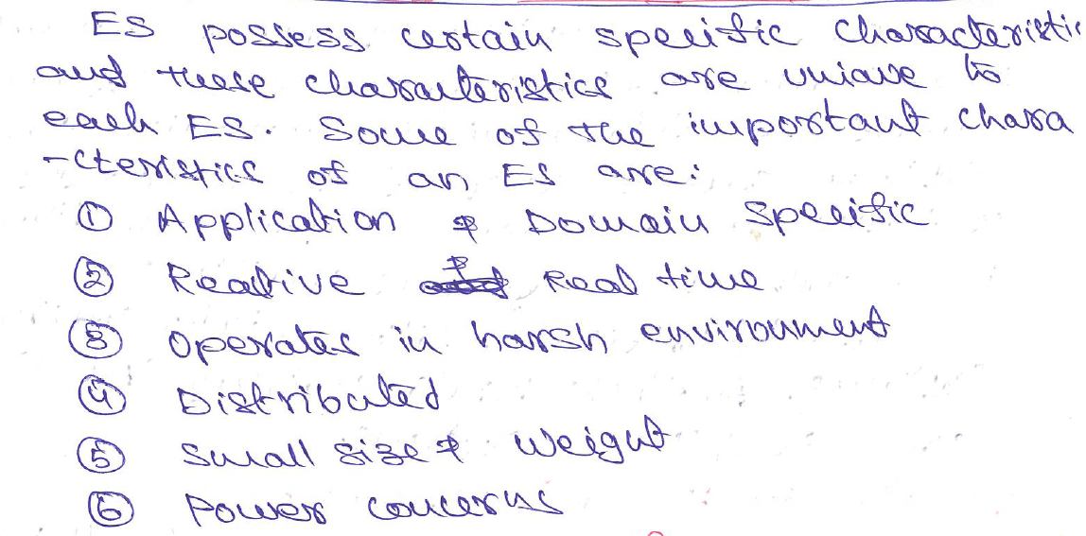
Characteristics of an Embedded System

Slide 3

Quality Attributes of Embedded System

Slide 4
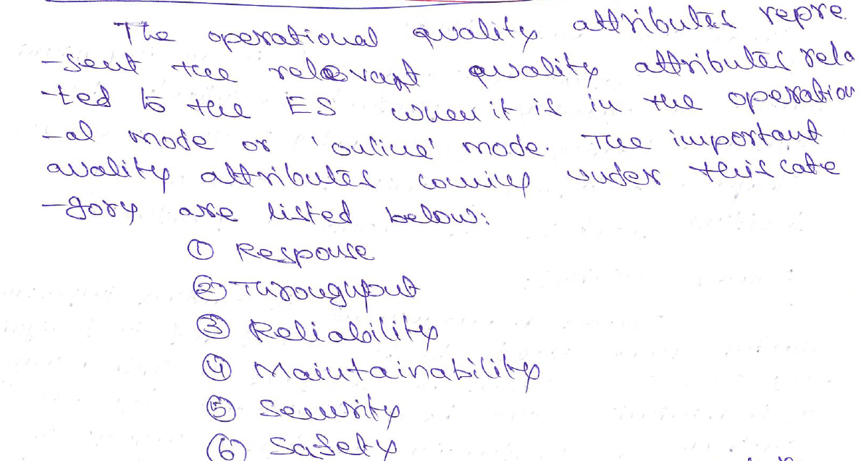
Operational Quality Attributes

Slide 5
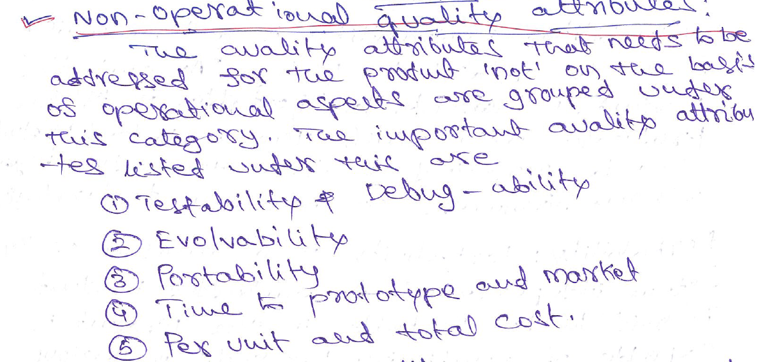
Non-Operational Quality Attributes

Slide 6

Application and Domain Specific ES

Slide 7
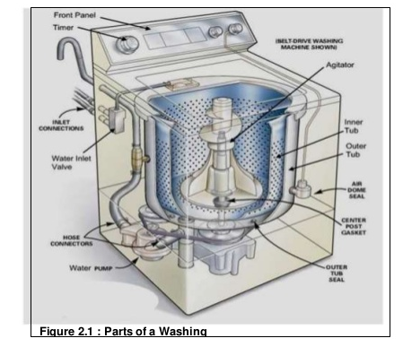
Washing Machine

Slide 8
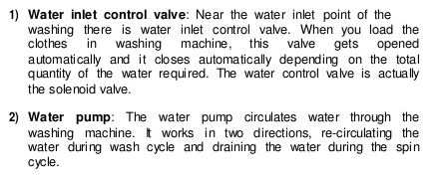
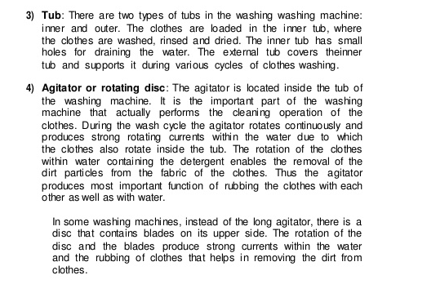

Slide 9
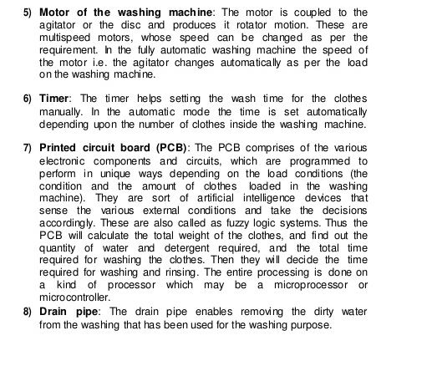

Slide 10
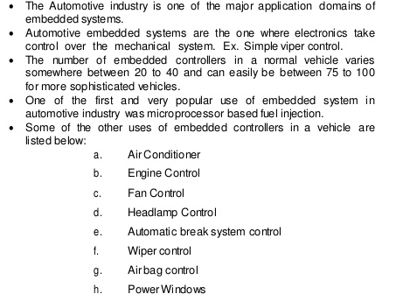
Domain Specific ES

Slide 11

Factors to be considered in selecting MC

Slide 12
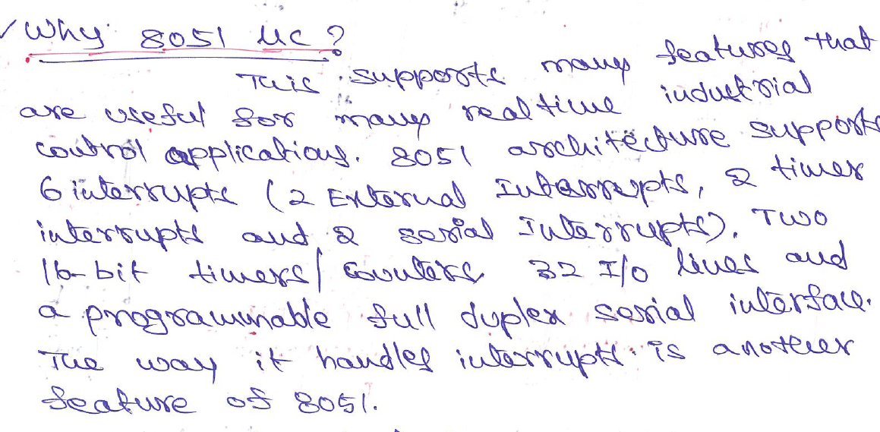
Microcontroller - 8051

Slide 13
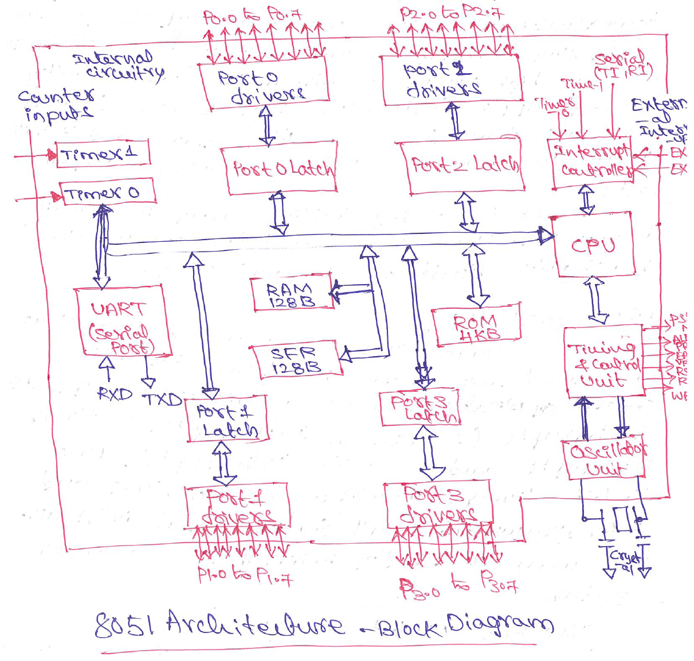

Slide 14


Slide 15
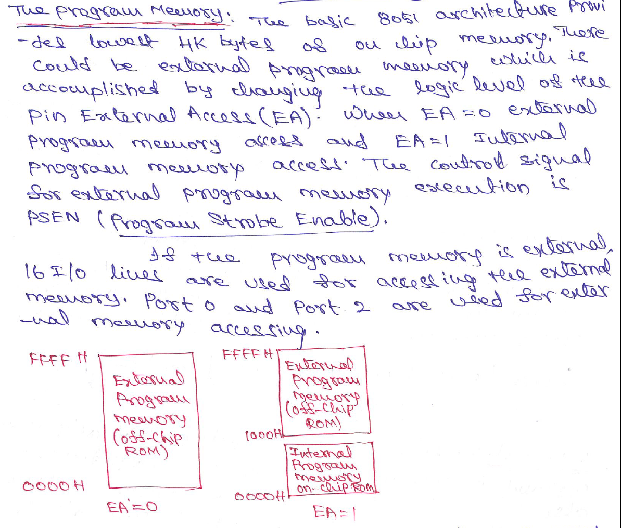

Slide 16



Slide 17
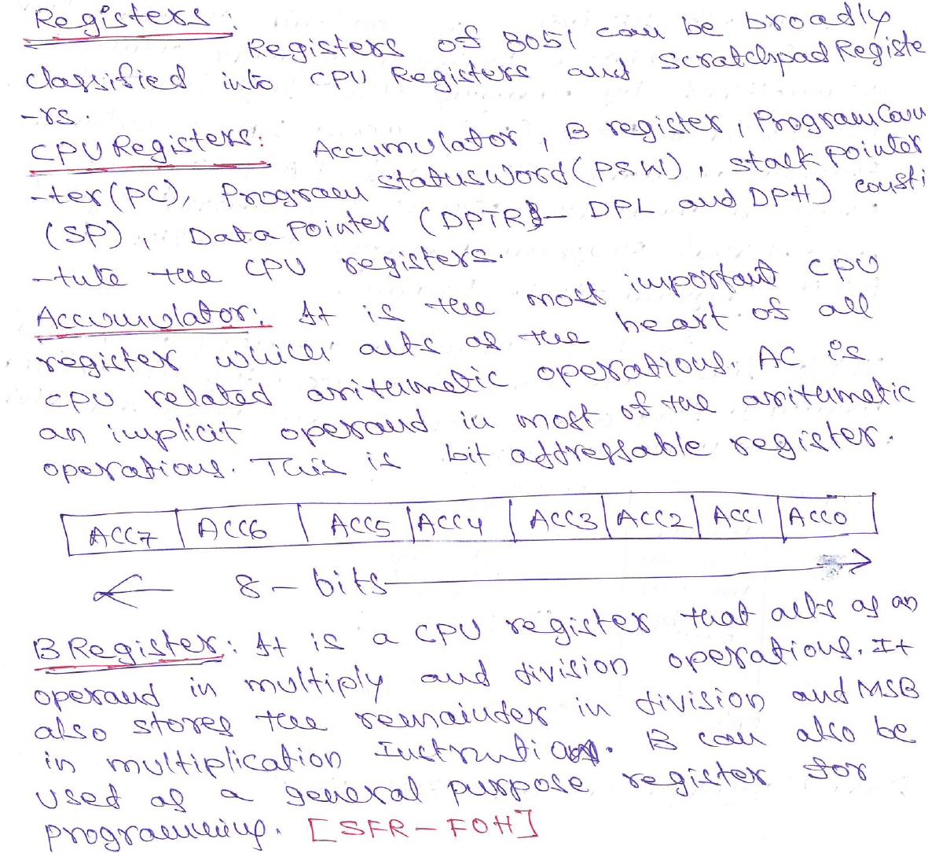

Slide 18
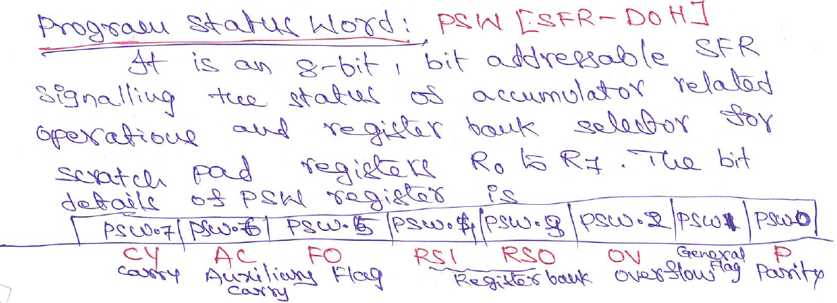
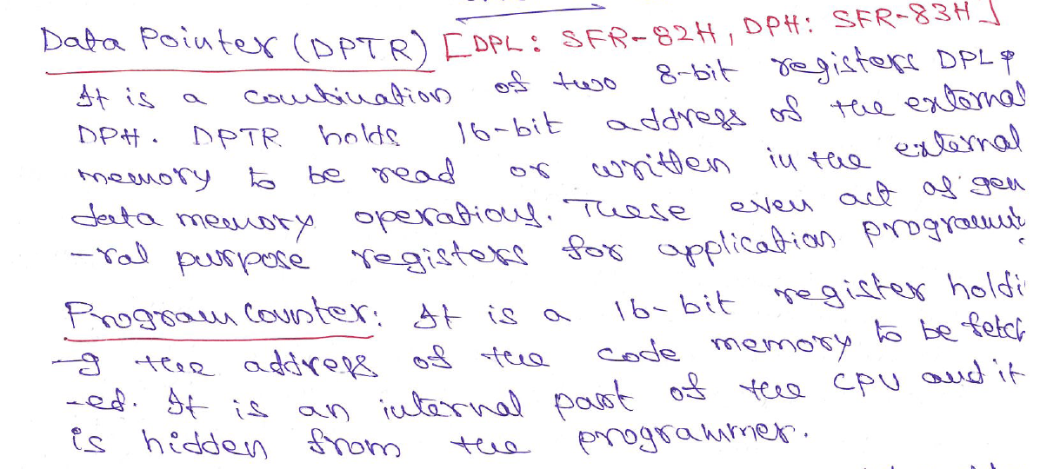

Slide 19


Slide 20
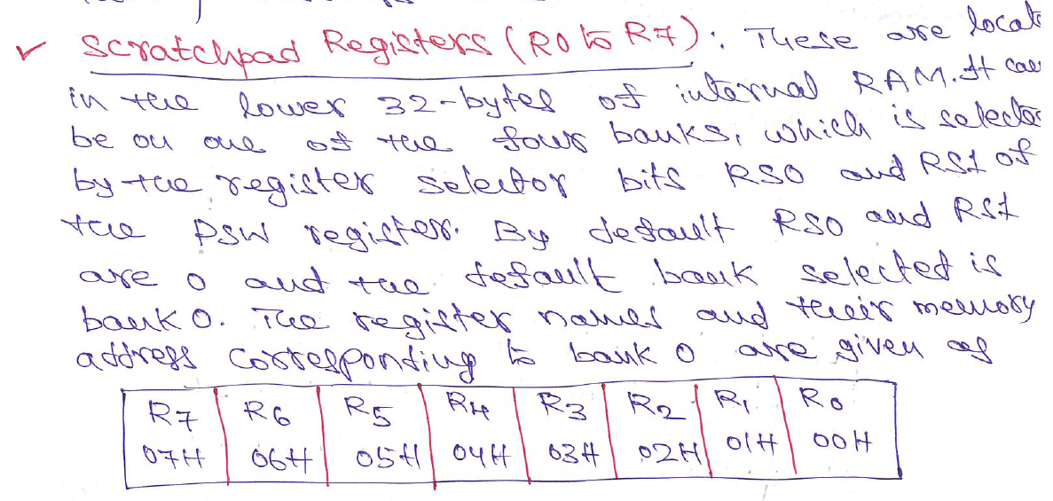


Slide 21
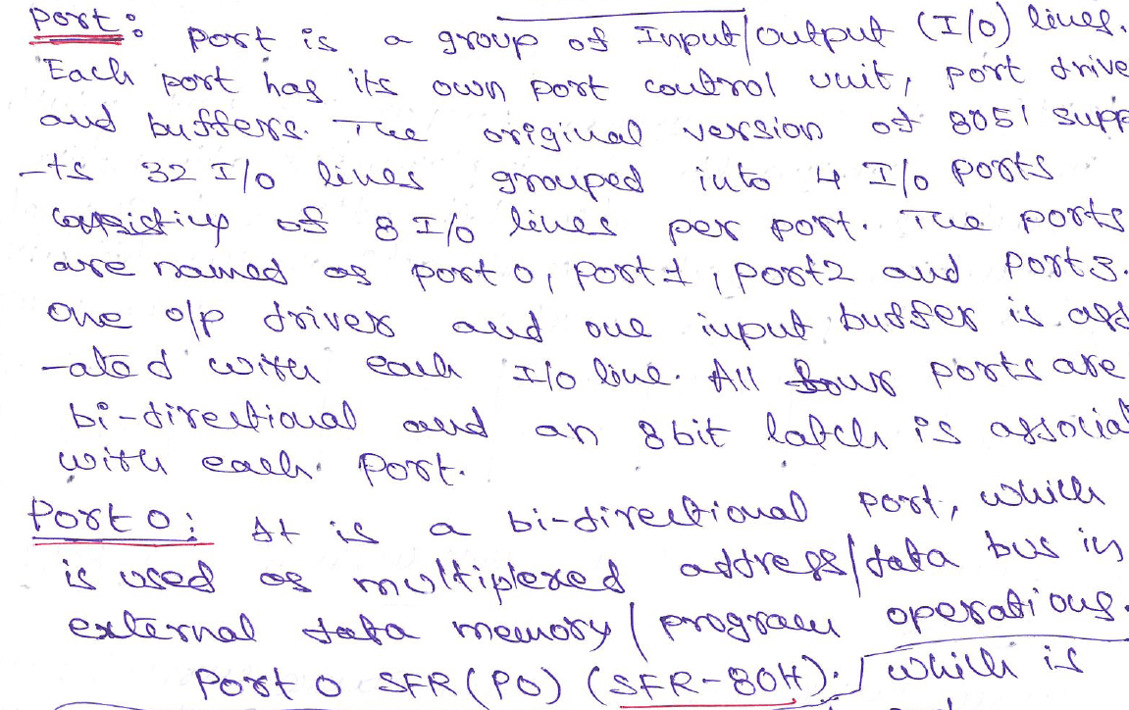

Slide 22
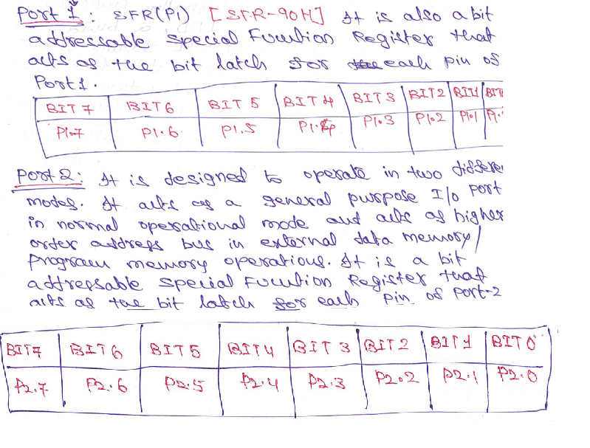

Slide 23
